Slide 1

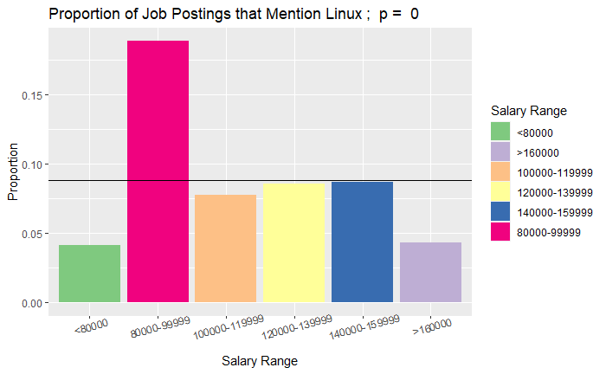
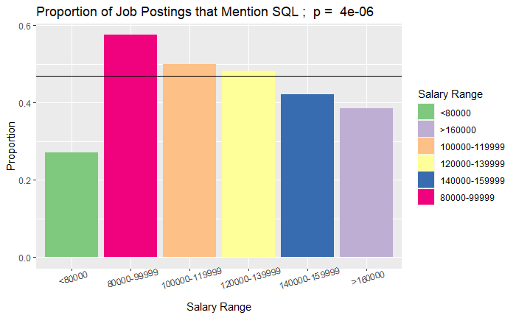
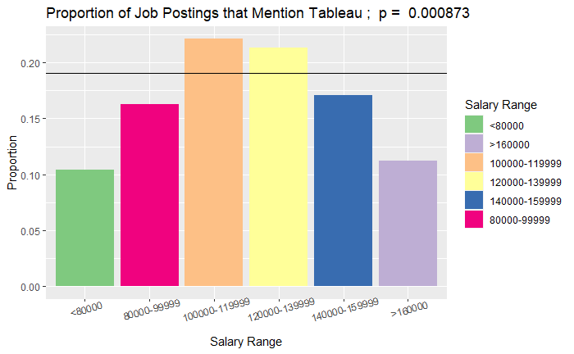
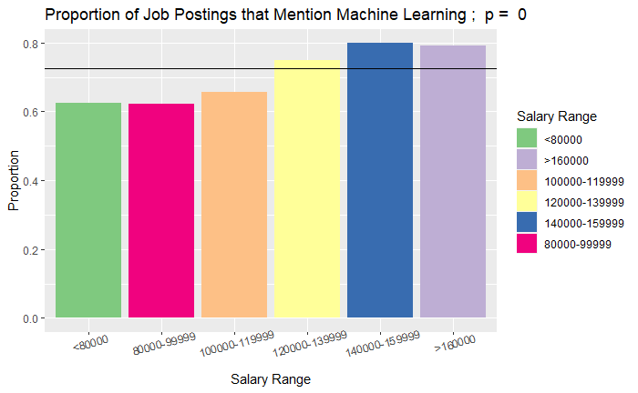
Proportion of Postings Requiring a Skill By Salary
Highlights Differences in Proportions Requiring a Skill Across Salary
P > 0.05, n > 200
About 20 Skills

Slide 2
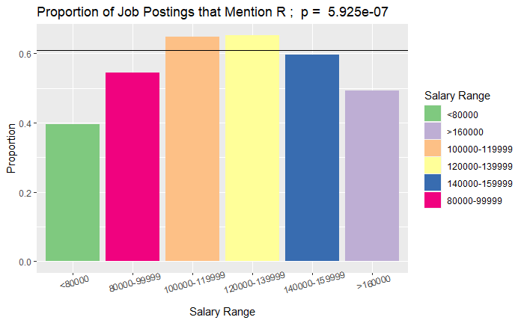
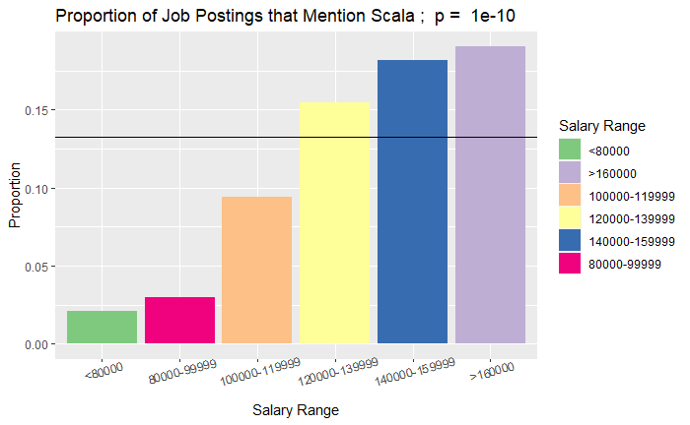
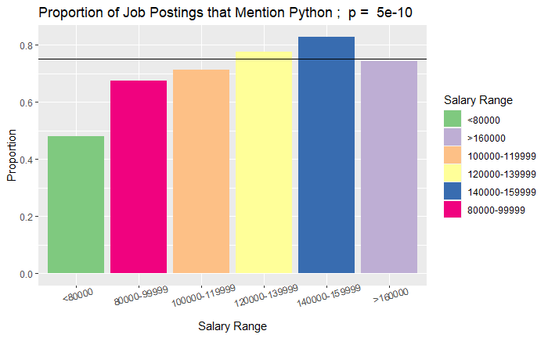
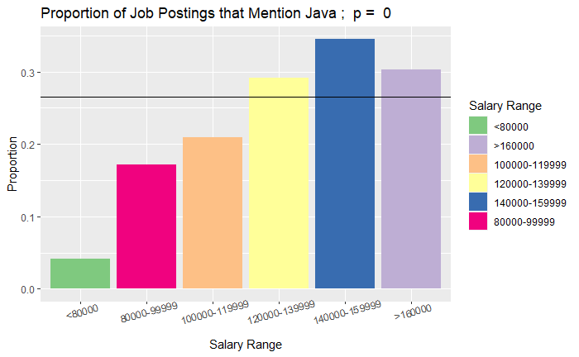
How do Programing Languages Perform

Slide 3
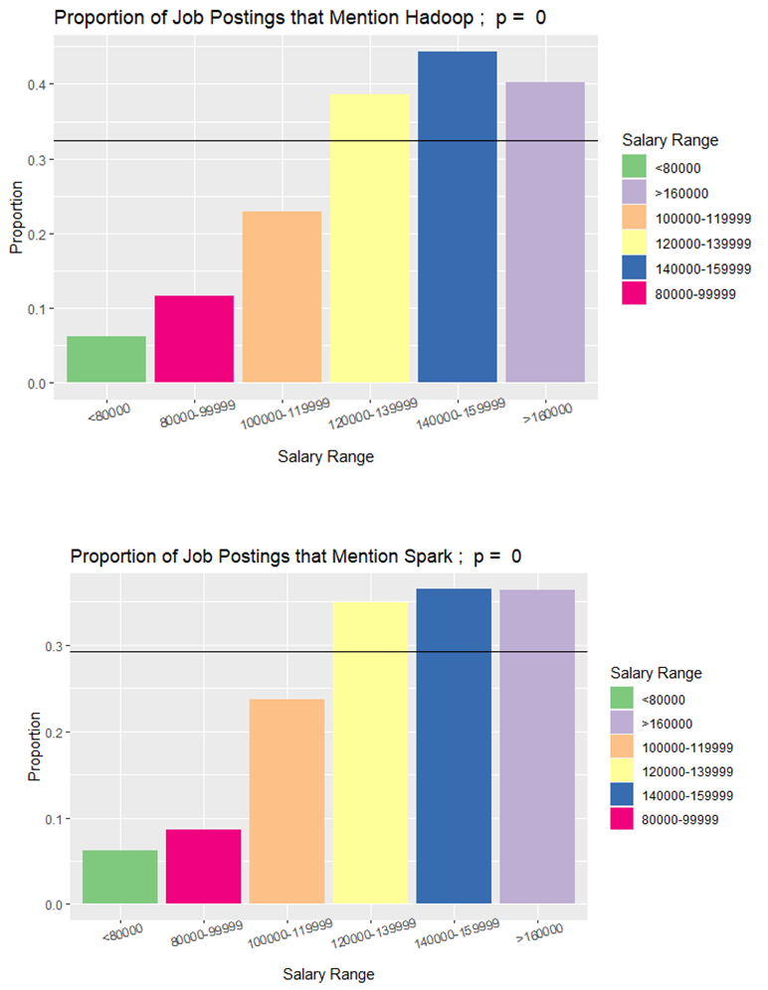
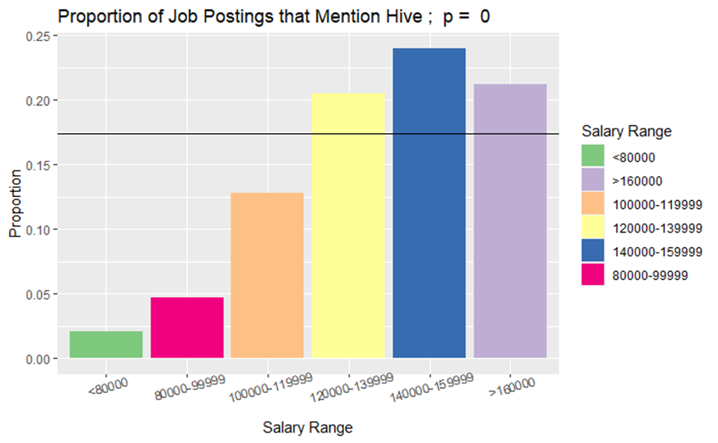
What Do High Paying Jobs Require (Specifically)?
C/C++, Hadoop, Hive, Java, NLP, Scala, Spark, and TensorFlow

